Slide 1






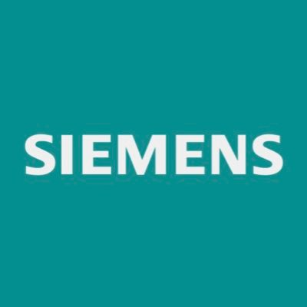








“Siemens Digital Software for AI Home Appliances”
Module: PRM7010 Agile Methodologies in the Digital Business Environment
Group Assignment:
24215373
STU1066043
STU1210642
24173427
24169993
Module Instructor: Mahtab Afsari

Slide 2

INTRODUCTION: SIEMENS DIGITAL INDUSTRIES SOFTWARE
Global Presence: Siemens AG is one of the world’s largest technology and manufacturing corporations, operating in 190+ countries with over 300,000 employees (Siemens, 2024).
Digital Focus: Siemens Digital Industries Software (DISW) drives the “Digital Enterprise” vision, integrating AI, IoT, automation, and cloud computing for digital transformation.
Core Offerings: Software platforms such as MindSphere (IoT), Teamcenter (product lifecycle), and Mendix (low-code) power digital innovation across industries.
AI-Enabled Home Appliances: Intelligent washing machines, smart ovens, and connected refrigerators using AI and data analytics for personalization and energy efficiency.
Digital Leadership: Siemens combines traditional engineering expertise with advanced digitalization strategies.

Slide 3
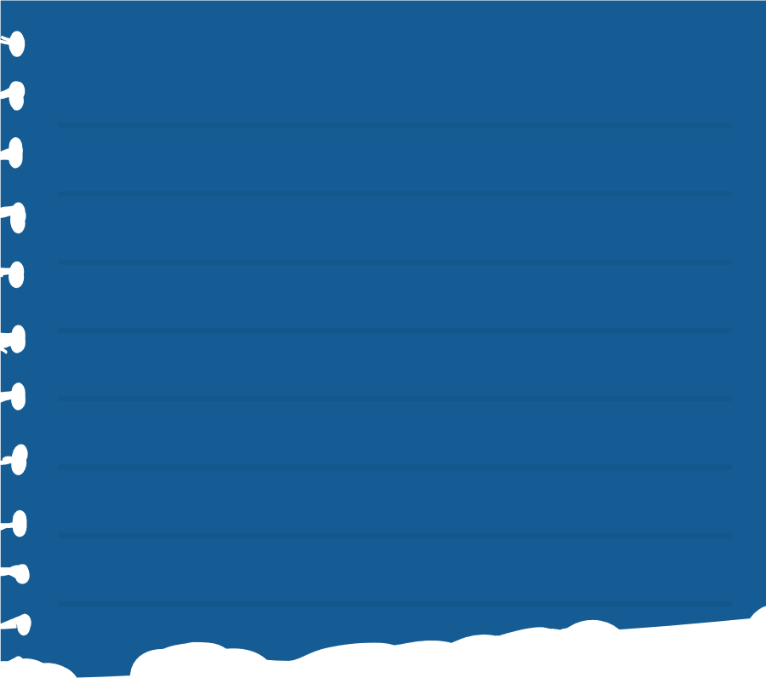

PROJECT RELEVANCE AND STRATEGIC FIT
WHY?
HOW?
FOR WHAT?
The AI-enabled home appliance initiative exemplifies Siemens’ commitment to sustainable, smart living, aligning with global digital transformation trends (Dennehy & Conboy, 2019).
Siemens is actively adopting Agile and SAFe practices to accelerate innovation and compete with digital-native companies like Samsung, Bosch, and Google (Dikert, Paasivaara & Lassenius, 2016).
Siemens integrates industrial heritage with digital innovation, showcasing real-world challenges of scaling agility in complex enterprises (Rigby, Sutherland & Takeuchi, 2016).
To align digital strategy with agile execution and deliver smarter, customer-centric innovations.
Notes:
“How” SAFe is being used in Siemens?
Siemens provides a compelling case study because it integrates industrial expertise with cutting-edge digital innovation, making it a pioneer in applying AI and IoT to both industrial and consumer markets. Its dual role as a traditional manufacturer and a digital enterprise illustrates the real-world challenges of scaling agility in complex, global organizations. (Petrik & Herzwurm, 2019)
“Why” Siemens is perfect example for SAFe Implementation?
Siemens was selected because its AI-enabled home appliances initiative sits at the heart of the digital business environment: The business addresses evolving customer expectations for smarter, connected, and sustainable living. (Siemens Advanta,2019) Furthermore, Siemens has actively pursued agile adoption across its digital software teams to remain competitive against tech-driven rivals like Samsung, Bosch, and Google, making it an ideal subject for exploring how Agile methodologies like SAFe can be applied to large-scale innovation. (RIETI, 2024)
“What” SAFe Agile Practices are being utilized at Siemens?
Studying Siemens allows us to explore how agile practices, particularly the Scaled Agile Framework (SAFe), can help overcome organizational silos, accelerate software delivery, and enhance collaboration across interdisciplinary teams. Insights from this case can also serve as a resourceful model for other enterprises facing similar challenges in aligning digital strategy with customer-centric innovation. (Siemens PLM, 2019)

Slide 4
INDUSTRIAL CHALLENGES & OPPORTUNITIES
Challenge/Opportunity | SAFe Practice to Address It | Why It Fits Siemens
Complexity of integration (AI, IoT, hardware) | Agile Release Trains (ARTs) | Synchronize multiple cross-functional teams working on hardware + software.
Speed to market | Program Increment (PI) Planning + Continuous Delivery Pipeline | Aligns global teams every 8–12 weeks, shortens delivery cycles, accelerates innovation.
Cross-functional collaboration | Scrum of Scrums + System Demos | Keeps global AI/IoT/software teams aligned and provides fast feedback loops.
Cultural transformation | Lean-Agile Leadership + Servant Leadership | Leaders model agile behaviors, empower teams, and shift culture from hierarchy to collaboration.
Sustainability & regulation | Lean Portfolio Management | Ensures innovation is aligned with compliance, ESG targets, and customer value.
Table 1: Siemens’s industrial Challenges and Opportunities with SAFe implementations.

Slide 5

Siemens AI Home Appliances (SAHA) Content:
SAHA is part of Siemens Digital Industries Software.
Focuses on embedding AI, IoT, and cloud into appliances (washing machines, smart ovens, etc.).
Mission: Deliver intelligent, sustainable, and adaptive solutions (Siemens, 2024).
Aligns with Siemens’ Digital Enterprise strategy for connectivity and innovation.
Image 1: AI Home appliances powered House depiction (personal collection, 2025)
Notes:
Product-Based Department: Siemens AI Home Appliances
Within Siemens Digital Industries Software, the AI-enabled Home Appliances department plays a strategic role in advancing Siemens’ vision for a digital enterprise. This department focuses on embedding artificial intelligence (AI), the Internet of Things (IoT), and cloud solutions into consumer appliances such as washing machines, refrigerators, and ovens. The department’s mission is to deliver intelligent, energy-efficient, and adaptive appliances, aligning with Siemens’ broader Digital Enterprise strategy that emphasizes connectivity, sustainability, and customer-centric innovation (Siemens, 2024).

Slide 6

S.A.H.A Project’s Budget Overview
Budget Highlights
Siemens invests €6B+ annually in R&D, prioritizing AI and digitalization (Siemens, 2024).
Focus on:
AI/ML model testing
IoT/cloud infrastructure (MindSphere, Azure)
UX/UI design & cybersecurity
Sustainability standards
Notes:
Siemens allocates over €6 billion annually to research and development (R&D), with a significant proportion directed toward digitalization and AI innovation (Siemens, 2024). For the AI appliances program, the budget priorities:
AI/ML model development and testing
IoT and cloud infrastructure (via platforms like MindSphere and Microsoft Azure partnerships)
UX/UI design for smart device interfaces
Cybersecurity and compliance with global regulations
Sustainability and efficiency testing
Management of the AI appliance initiative follows Siemens’ layered governance structure, where program managers oversee execution, product owners manage product roadmaps, and release train engineers (RTEs) coordinate Agile teams at scale (Scaled Agile Inc., 2021).
Resources include:
Human capital: AI engineers, IoT specialists, data scientists, UX designers, Agile coaches, and hardware engineers.
Technical resources: Siemens’ Mendix low-code platform, Teamcenter Product Lifecycle Management (PLM) for collaboration, and MindSphere IoT for connected ecosystems.
Organizational resources: Siemens’ Digital Experience Centers, which foster Agile innovation and prototyping across global hubs (Siemens, 2023).

Slide 7

SAFe IMPLEMENTATION STEPS
Preparation & Training – SAFe training and LACE setup.
Vision & Backlog Creation – Define program vision and break down epics (Cohn, 2004).
ART Formation – Assign roles (Product Owners, Architects, RTEs).
PI Planning – 8–12-week cycles.
Execution – 2-week sprints; continuous testing.
Reviews & Retrospectives – Feedback and improvement (Schwaber & Sutherland, 2020).
Continuous Delivery Pipeline – DevOps automation.
Portfolio Alignment – Lean portfolio management (Scaled Agile Inc., 2021).
Notes:
Implementing SAFe for Siemens’ AI appliance department requires the following steps:
Preparation and Training
Provide SAFe training for leadership, program managers, and Agile teams.
Establish a Lean-Agile Center of Excellence (LACE) to guide transformation.
Vision and Backlog Creation
Define the program vision (e.g., “AI-powered appliances for sustainable living”).
Develop epics such as predictive maintenance or adaptive energy optimization.
Break down epics into features and user stories (Cohn, 2004).
Agile Release Train (ART) Formation
Organize ARTs for specific product lines (e.g., ovens, washing machines).
Assign Product Owners, System Architects, and RTEs.
Program Increment (PI) Planning
Conduct PI planning sessions every 8–12 weeks.
Teams plan sprint objectives, dependencies, and deliverables collaboratively.
Execution (Sprints & Iterations)
Run 2-week sprints with Scrum teams.
Deliver incremental features (e.g., AI-based wash cycle recommendations).
Ensure continuous integration and automated testing.
Reviews and Retrospectives
Hold system demos at the end of each iteration.
Capture user feedback and refine future iterations.
Conduct retrospectives to improve team performance (Schwaber & Sutherland, 2020).
Continuous Delivery Pipeline
Implement DevOps for automated deployment and faster delivery cycles.
Test AI features in pilot markets before global rollout.
Portfolio Alignment
Apply Lean Portfolio Management to ensure investments align with Siemens’ strategy on digitalization, sustainability, and customer value (Scaled Agile Inc., 2021).

Slide 8

Scaled Agile Framework (SAFe) Methodology
Ideal for large, multi-team enterprises like Siemens.
Synchronizes global Agile teams (VersionOne, 2020).
Encourages leadership buy-in, incremental delivery, and PI planning for shorter feedback loops.
Combines Scrum and Kanban under enterprise governance.
Notes:
The most suitable methodology for Siemens’ AI Home Appliances project is the Scaled Agile Framework (SAFe).
Justification:
Siemens is a multinational, multi-team organization that necessitates collaboration between many business divisions. Such extensive adaptability is made possible by SAFe's Lean Portfolio Management and Agile Release Trains. A systematic framework that synchronizes various Agile teams is necessary due to the complexity of integrating AI, IoT, cloud, and hardware (VersionOne, 2020). SAFe's focus on leadership buy-in and incremental value delivery is beneficial to Siemens' cultural shift from a traditional industrial model to an Agile digital company. SAFe's continuous delivery pipeline and Program Increment (PI) planning shorten feedback loops to accelerate time-to-market. SAFe offers the scale and control required for Siemens' intricate, international R&D operations, while Scrum and Kanban may function well at the team level.

Slide 9




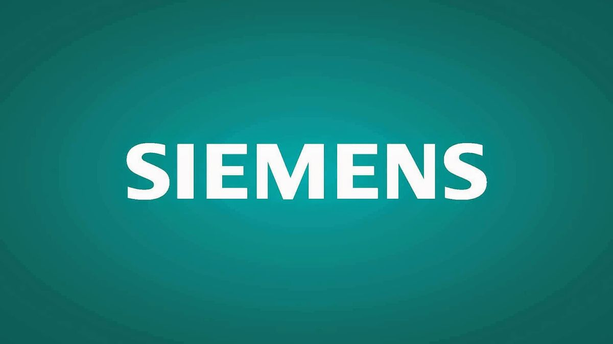
SIMENS MARKET DIFFERENTIATION VIA SAFe FRAMEWORK
Faster innovation and reduced time-to-market.
Stronger global collaboration.
AI-powered energy optimization for sustainability.
Enhanced customer satisfaction.
Siemens is positioned as a digital pioneer in smart appliances.
Image 4 : Siemens SAFe Implementation Market Strategies. (Personal Collection, 2025)
Notes:
By implementing SAFe, Siemens can achieve the following:
Accelerated innovation cycles, reducing time-to-market.
Enhanced collaboration across hardware, software, and AI teams.
Improved sustainability through AI-powered energy optimization.
Market leadership by combining industrial expertise with agile digital innovation.
Producing appliances tailored to user needs. Which increases product valuation and Customer loyalty through Feedback.
As a result, Siemens is positioned as a leading brand worldwide in home appliance industry as both a manufacturer and a digital innovator thanks to Agile transformation through SAFe Method.

Slide 10
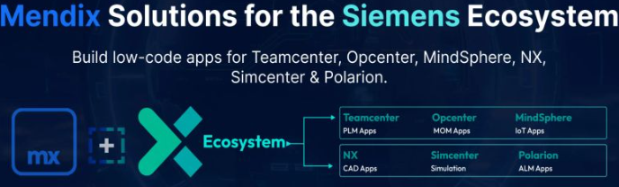
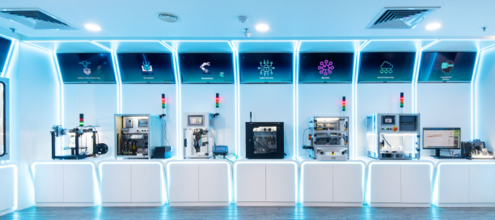
Siemens Management Structure & Resources
Resources
Human: AI engineers, IoT experts, data scientists, UX designers.
Technical: Mendix, Teamcenter PLM, MindSphere.
Organizational: Digital Experience Centers (Siemens, 2023).
Image 2: AI Home appliances powered ecosystem (Siemens, 2025)
Image 3: Siemens Digital Experience Center in Berlin (Siemens, 2025)
Notes:
Management of the AI appliance initiative follows Siemens’ layered governance structure, where program managers oversee execution, product owners manage product roadmaps, and release train engineers (RTEs) coordinate Agile teams at scale (Scaled Agile Inc., 2021).
Resources include:
Human capital: AI engineers, IoT specialists, data scientists, UX designers, Agile coaches, and hardware engineers.
Technical resources: Siemens’ Mendix low-code platform, Teamcenter Product Lifecycle Management (PLM) for collaboration, and MindSphere IoT for connected ecosystems.
Organizational resources: Siemens’ Digital Experience Centers, which foster Agile innovation and prototyping across global hubs (Siemens, 2023).

Slide 11
Siemens Management Structure
Siemens Corporation
Siemens AI Powered Home Appliance Department
Dishwasher
Program Manager
Washing Machine
Program Manager
Air Conditioners
Program Manager
Microwave Oven
Program Manager
Project Manager
Project Manager
Project Manager
Project Manager
Project’s Cloud Engineers and Software Developers (AI Integration)
Figure 1: Siemens SAFe Project Management and Governance Flowchart (Scale Agile Inc., 2021)

Slide 12

SIEMENS STRATEGIC GOALS
Four Core Goals
Customer-centric innovation.
Faster time-to-market.
Sustainability.
Market differentiation (Gartner, 2023).
Vision Alignment: Supports Siemens’ commitment to smart, sustainable living.
Notes:
The AI appliance program is driven by four main goals:
Customer-Centric Innovation: Deliver adaptive appliances that learn from user behavior.
Faster Time-to-Market: Achieve shorter product development cycles via iterative releases.
Sustainability: Ensure appliances meet global energy efficiency standards.
Market Differentiation: Compete effectively with digital-native rivals such as Samsung, Bosch, and Google (Gartner, 2023).
These goals align with Siemens’ vision of becoming a leader in smart, sustainable living solutions.

Slide 13

CROSS-FUNCTIONAL TEAMS
Agile Release Trains (ARTs): 50–125 people per product line.
Scrum Teams: Focused on specific features (e.g., predictive maintenance).
System Architects: Define AI/IoT architecture.
Product Manager: Manage the product backlog to customer needs.
RTEs: Coordinate Agile execution globally (Scaled Agile Inc., 2021).
Notes:
The program involves several cross-functional teams:
Agile Release Trains (ARTs): Large teams (50–125 people) aligned with specific product lines (e.g., AI washing machines).
Scrum Teams: Small, autonomous teams focusing on features such as predictive maintenance or voice recognition.
System Architects: Responsible for defining AI and IoT architecture.
Product Management: Ensures product backlogs align with customer needs.
Release Train Engineers (RTEs): Coordinate Agile execution across global teams and implementation of AI software (Scaled Agile Inc., 2021).

Slide 14
SIEMENS RISK MITIGATION STRATEGIES
Risk | Mitigation Strategy | Source
Cultural resistance | Create LACE, Agile champions, leadership training | Kotter (2012)
SAFe complexity | Pilot ARTs before scaling | Scaled Agile Inc. (2021)
Global coordination | Use hybrid PI planning, Jira, Miro | Denning (2018)
Compliance/security | Embed experts, regulatory audits | Schwaber & Sutherland (2020)
Skill gaps | Continuous learning, expert hiring | Cohn (2004); Denning (2018)
Table 2: Siemens project’s Risk Mitigation Strategies.
Notes:
While SAFe provides a clear roadmap for Siemens’ Agile transformation, certain risks may challenge implementation(VersionOne, 2020).
By proactively identifying and mitigating these risks enhances success and alignment with Siemens’ strategic objectives (Scaled Agile Inc., 2021)
1. Cultural Resistance
Risk: Employees accustomed to traditional management may resist Agile practices.
Mitigation: Establish a Lean-Agile Center of Excellence (LACE), offer servant leadership training, and appoint Agile champions across departments (Kotter, 2012).
2. Overhead and Complexity of SAFe
Risk: Scaling SAFe across Siemens’ global operations could create bureaucratic overhead.
Mitigation: Launch pilot Agile Release Trains (ARTs) on select product lines, evaluate results, and scale gradually (Scaled Agile Inc., 2021).
3. Global Coordination Challenges
Risk: Distributed teams may struggle with time zones and collaboration issues.
Mitigation: Use hybrid Pipeline planning workshops, and digital collaboration tools such as Jira, Miro, and Microsoft Teams (Denning, 2018).
4. Compliance and Security Risks
Risk: Rapid iterations may overlook cybersecurity and regulatory standards.
Mitigation: By embedding compliance experts within Agile Release Trains, define regulatory checks in the Definition of Done (DoD), and conduct regular audits (Schwaber & Sutherland, 2020).
5. Resource and Skill Gaps
Risk: Limited expertise in AI, IoT, or Agile may hinder progress.
Mitigation: Provide continuous learning programs, hire specialized experts, and encourage knowledge-sharing sessions (Cohn, 2004; Denning, 2018).

Slide 15
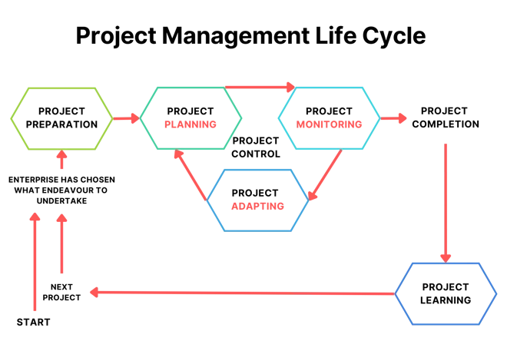
PROJECT MONITORING & EVALUATION
Siemens AI Appliance program delivers value, quality, and sustainability, by constant project monitoring and evaluation.
With the help of “AI path” for manufacturing simulation in its project life cycles, by utilizing Heuristic data sets. (Siemens Digital Industries Software, 2024).
This provide speed of delivery with customer satisfaction and strategic alignment.
Project Evaluation cycle
Figure 2 : Project Management life Cycle. (Personal Collection, 2025)
Notes:
One of the most important phase of project life cycle that extends from the start till the end. It is called the monitoring and evaluation Phase. (M&E) is critical to ensuring that Siemens' Agile transformation within the AI-enabled home appliances division delivers value consistently and aligns with its strategic vision of sustainability, digitalization, and customer-centric innovation (Rigby, Sutherland, & Takeuchi, 2016).
Siemens can track delivery efficiency, product quality, team health, and long-term strategic alignment by using "AI paths" to run manufacturing simulations and combine quantitative flow-based metrics (Ducharme, 2023) with qualitative feedback loops of heuristic data (Schwaber & Sutherland, 2020).
This continuous inspection and adaptation is vital throughout the entire agile project lifecycle (Rubin, 2013), ensuring that projects stay on track and deliver expected benefits. (Siemens Digital Industries Software, 2024).

Slide 16
AGILE FLOW & DELIVERY METRICS
Product Trends
Flow Velocity
Flow Time
Cycle Time Efficiency
Flow Predictability
Commitments vs. Delivery
Figure 3 : Siemen’s Agile flow and Delivery Metrics. (Siemens, 2025)
Notes:
The effectiveness of value delivery across Agile Release Trains (ARTs) is shown by the flow-based metrics. The "Measure and Grow" competence model of the Scaled Agile Framework (SAFe) promotes the use of the Flow Framework Flow Velocity: Shows productivity trends over time by counting the number of features, stories, or capabilities completed per iteration (Agile Hive, 2023).
Flow Time: The amount of time it takes for a task to go from beginning to end, which helps Siemens provide AI capabilities as quickly as possible (Agile Hive, 2023).
Flow Predictability: Verifies that Siemens fulfills its promises to customer-focused innovation by comparing planned and accomplished goals every Program Increment (PI) (Planview, 2024).

Slide 17

TEAM & PRODUCT
QUALITY & PROCESS MANAGEMENT
Customer-Centric Metrics
Customer Satisfaction (CSAT)
Net Promoter Score (NPS)
Adoption rates of AI features (e.g., smart wash cycles)
Agile Maturity Assessments (SAFe Business Agility)
Product Quality (Defect Density & Escaped Defects)
Test Automation Coverage
Retrospectives Scrum Meetings (continuous improvement)
Employee Engagement / eNPS surveys
Notes:
Siemens needs to monitor results about product quality and customer satisfaction, while keeping the team motivated and empowered with the help of Agile process management:
Agile process management provides flexibility, motivation strategies and empower project teamwork with the help of collaboration tools.
For Team Quality Siemens conduct: Agile Maturity Assessments: Applying SAFe's Business Agility Assessment to evaluate competencies in Lean Portfolio Management, Agile Product Delivery, and Team Agility (Scaled Agile Inc., 2021).
For Product and Process Quality Management Siemens Measures:
Defect Density and Escaped Defects:
To guarantee the quality of delivered appliances, software flaws must be monitored via:
Test Automation Coverage: The proportion of automated testing in CI/CD pipelines lowers the possibility of regressions or the introduction of new issues (Agilemania, 2022).
Customer Feedback Metrics: Adaptive features such as predicted wash cycles are evaluated using Customer Satisfaction (CSAT) scores and the Net Promoter Score (NPS) (Atlassian, 2024).
Adoption Rates: Monitoring the number of consumers utilizing AI-powered capabilities in various appliances (Gartner, 2023).
Retrospectives Scrum Meeting : Holding reviews after each iteration to capture lessons learned and find opportunities for improvement (Schwaber and Sutherland, 2020).
Employee Engagement Surveys: Using pulse surveys and employee Net Promoter Score (eNPS) to monitor the cultural shift from a traditional hierarchy to an Agile way of working (Gocious, 2023).
Scaled Agile Framework helps to track these matrixes for Siemens to guarantee an healthy team environment and consistent quality product delivery in line with consumer preferences.

Slide 18
STRATEGIC ALIGNMENT & GOVERNANCE
Objectives & Key Results (OKRs) to sustainability & innovation goals
Compliance KPIs → energy efficiency, data protection, AI ethics
Portfolio Kanban → track epics from idea to delivery
Figure 4 : Siemen’s Strategic Alignment and Governance Venn diagram. (Siemens, 2025)
Notes:
These three parameters are set for Siemens to ensure its innovation investments are aligned with the company's broader goals around digitalization and sustainability:
Objectives and Key Results (OKRs): Linking Program Increment (PI) objectives to Siemens' overarching strategies for sustainability and customer-centric innovation.
Portfolio Kanban: Monitoring the progress of AI-powered initiatives from the idea stage to actual delivery (Scaled Agile, Inc., 2021).
Sustainability and Compliance KPIs: Measuring things like energy efficiency, reduction in carbon footprint, and compliance with data protection laws (Siemens, 2024).
This makes sure that success at the project level translates into concrete business results.

Slide 19
IDENTIFYING AND MAPPING STAKEHOLDERS
 | High Interest | Low Interest
High Influence | Manage Closely | Keep Satisfied
 | Executives/Business Owners | Regulatory Bodies
 | Product Owners & Key Clients
Low Influence | Keep Informed | Monitor
 | Agile Teams (AI, IoT, UX) | Broader User Groups / Community
 | Customers & End-users
Table 3 : Siemen’s Agile PM Tools. (Personal Collection, 2025)
Notes:
This slide maps Siemens key stakeholders by their interest and influence:
Executives and Regulatory Bodies have high influence and interest, so they manage them closely with regular updates.
Product Owners and Key Clients have high influence but less daily involvement; they keep them satisfied. Agile Teams and user communities are very interested but less influential; they keep them informed.
Customers have lower influence and interest; they monitor and update them as needed.
This approach ensures the right communication for each group, supporting project success.

Slide 20
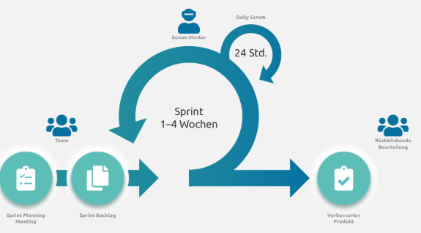
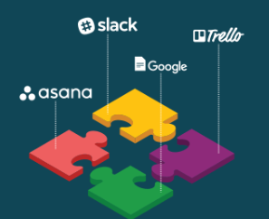
ENGAGEMENT, COMMUNICATION, AND COLLABORATION MECHANISMS
Engagement Channels:
Regular stakeholder workshops (vision alignment, PI/sprint reviews)
System demos (frequent, to showcase progress & gather feedback)
Shared digital dashboards & project portals for real-time transparency (Value Glide, 2025; Working Well, 2023)
2. Collaboration Tools:
Slack, Microsoft Teams: real-time updates, Q&A
Miro: collaborative design/feedback sessions
Jira & Confluence: agile tracking and documentation (Agile Hive, 2023; Siemens AG, 2016)
Image 3: Agile PM Tools. (Personal Collection, 2025)
Notes:
Here we are showing how Siemens engage and collaborate with stakeholders throughout the project.
They use regular workshops like vision alignment sessions, sprint reviews, and showcases to share progress and gather feedback. These create real-time transparency and keep everyone aligned on project goals.
For communication and collaboration, they leverage digital tools such as Microsoft and Google Team for instant updates and Q&A, Miro for design and feedback collaboration, and Jira and Confluence for agile tracking and documentation.

Slide 21
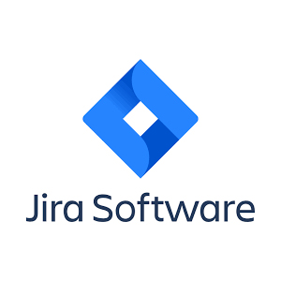
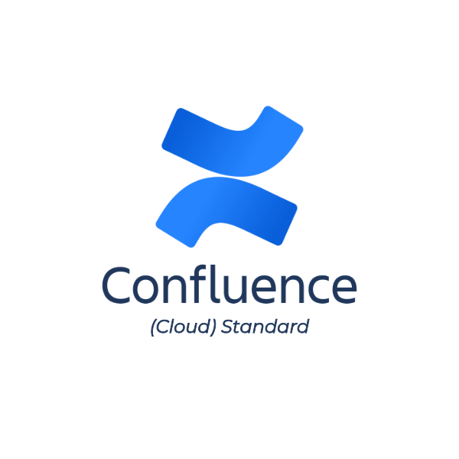
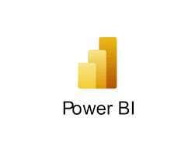
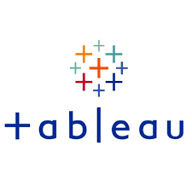
PROJECT MONITORING TOOLS
Image 4 : Siemen’s Agile PM Tools. (Personal Collection, 2025)
Notes:
To effectively monitor and evaluate performance, Siemens can use:
Jira and VersionOne for tracking user stories, velocity, and sprint burndown charts.
Confluence for documenting retrospectives and capturing lessons learned.
Power BI/Tableau for integrating financial, sustainability, and Agile metrics into executive dashboards.
Using visualization tools makes monitoring and evaluation transparent, accessible, and actionable across the organization.
Together, these mechanisms ensure effective engagement, clear communication, and smooth teamwork across distributed and cross-functional teams.

Slide 22
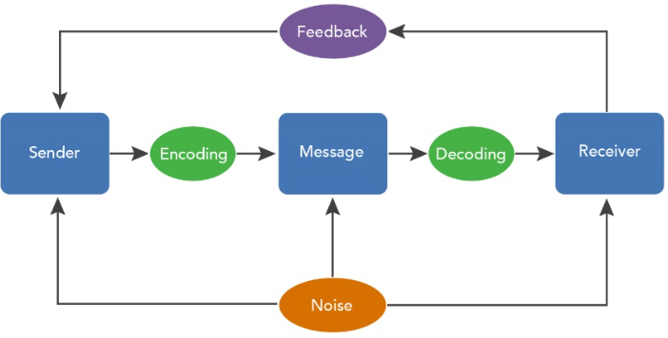
ENGAGEMENT, COMMUNICATION, AND COLLABORATION MECHANISMS
3. Co-Design & Feedback Examples:
Sprint review sessions open to clients and end-users
Internal hackathons or joint ideation workshops (partner participation)
Digital feedback forms embedded in appliance user interfaces (Working Well, 2023; Value Glide, 2025)
4. Communication Loops in SAFe:
PO Sync & Scrum Master Sync (keeps teams aligned)
System demos and Inspect & Adapt sessions (building trust and shared direction) (Scaled Agile Inc., 2021; Value Glide, 2025)
Image 5: Communication Feedback Loop. (Personal Collection, 2025)
Notes:
Siemens focus on how co-design and continuous feedback help them build better AI home appliances with there stakeholders.
Co-design happens through sprint review sessions open to clients and end-users, allowing direct feedback at every stage. They also hold joint ideation workshops where partners collaborate creatively, making sure their insights shape the product from early on. Plus, they use digital feedback tools embedded directly into the appliances, so users can share their thoughts in real time. Next, communication loops keep the whole team aligned and effective. Using the SAFe framework, they have regular PO and Scrum Master syncs that coordinate efforts and clarify priorities. Demo sessions and Inspect & Adapt meetings build trust by showing progress openly and adjusting based on real-world input. Together, these approaches foster transparency, teamwork, and shared ownership, which are critical for successfully delivering innovative AI solutions at Siemens.
Next, communication loops keep the whole team aligned and effective. Using the SAFe framework, they have regular PO and Scrum Master syncs that coordinate efforts and clarify priorities. Demo sessions and Inspect & Adapt meetings build trust by showing progress openly and adjusting based on real-world input.Together, these approaches foster transparency, teamwork, and shared ownership, which are critical for successfully delivering innovative AI solutions at Siemens.

Slide 23
CONCLUSION
Agile Transformation: Siemens’ digital transformation highlights how Agile methodologies, especially the Scaled Agile Framework (SAFe), help large organizations innovate efficiently at scale.
Cross-Functional Collaboration: Through integrated teams and iterative feedback loops, Siemens bridges industrial engineering with digital innovation.
Strategic Alignment: Lean portfolio management ensures that business goals, technology development, and customer needs remain aligned.
Faster Innovation: Agile enables quicker product development and improved market responsiveness, keeping Siemens competitive in a fast-evolving digital landscape.
Sustainability Focus: Agile practices support Siemens’ commitment to energy efficiency, smart design, and sustainable innovation.
Mindset Shift: Agility at Siemens goes beyond processes, it is a strategic mindset that drives collaboration, adaptability, and continuous improvement across global teams.
(Collis & Junker, 2020 ; Siemens AG, 2024 ; Fritzsch et al., 2022)
Notes:
To conclude, Siemens’ digital transformation journey is a great example of how Agile especially the Scaled Agile Framework, or SAFe can help large organizations innovate effectively.
By adopting Agile, Siemens has shifted from traditional, linear processes to a more flexible, team-based approach that values learning and adaptability.
First, this transformation has allowed Siemens to combine its strong industrial background with digital agility. With SAFe, teams across the world can now work together smoothly innovating faster while maintaining quality and consistency.
Second, collaboration has become the heart of how Siemens works. Cross-functional teams of developers, engineers, data scientists, and designers now work in short, iterative cycles. They test ideas quickly, gather feedback, and improve continuously which helps bridge the gap between engineering and digital innovation.
Third, Siemens ensures all this innovation stays aligned with its business goals. Through lean portfolio management, every project and sprint directly supports customer needs and the company’s larger vision.
Agile has also made Siemens much efficient in product innovation and development. The company can now deliver updates and new solutions quickly, giving it a strong advantage in the fast-changing digital market. Another key result is sustainability. Agile focus on continuous improvement helps Siemens design smarter, energy-efficient, and environmentally responsible products like AI-powered appliances that optimize energy use.
And finally, Siemens shows that agility is more than just a process it’s a mindset. It’s about creating a culture of teamwork, adaptability, and constant growth. Overall, Siemens’ journey proves that true digital transformation doesn’t start with technology it starts with an agile mindset that empowers people to think, work, and create together.

Slide 24
REFERENCES
Agile Hive (2023) 'Agile Metrics: Flow Velocity.' Available at: https://agile-hive.com/agile-metrics-flow-velocity (Accessed: 11 October 2025).
Agile Hive, 2023. Understanding Flow Metrics in SAFe®: A Beginner’s Guide. Agile Hive. Available at: https://agile-hive.com/blog/understanding-flow-metrics-in-safe/ [Accessed 4 October 2025].
Agilemania, 2022. SAFe® Metrics for Agile Transformation. Agilemania. Available at: https://agilemania.com/safe%C2%AE-metrics-for-agile-transformation [Accessed 4 October 2025].
Atlassian, 2024. Agile Project Management Metrics. Atlassian. Available at: https://www.atlassian.com/agile/project-management/metrics [Accessed 4 October 2025].
Collis, D.J. & Junker, T., 2020. Digitalization at Siemens. Harvard Business School Teaching Note 720‑462.
Ducharme, D. (2023). Agile Metrics: The Ultimate Guide. Atlassian. Retrieved from https://www.atlassian.com/agile/metrics
Fritzsch, J., Bogner, J., Haug, M., da Silva, A.C.F., Rubner, C., Saft, M., Sauer, H. & Wagner, S., 2022. “Adopting microservices and DevOps in the cyber-physical systems domain: A rapid review and case study”, arXiv preprint arXiv:2210.06858.
Gartner, 2023. Emerging Tech: The Future of the Smart Home. Gartner Research. Available at: https://www.gartner.com/en/documents/5810115 [Accessed 4 October 2025].
Gocious, 2023. Three Agile Metrics to Track and Measure Outcomes, Flow, Competency. Gocious. Available at: https://gocious.com/blog/three-agile-metrics-to-track-and-measure-outcomes-flow-competency [Accessed 4 October 2025].
Infomineo (2025) 'Five stakeholder mapping models every professional should know.' Available at: https://infomineo.com/blog/five-stakeholder-mapping-models-every-professional-should-know/ (Accessed: 11 October 2025).
Novikov, S.V. and Sazonov, A.A. (2019) ‘Application of the open operating system “MindSphere” in digital transformation of high-tech enterprises’, Economics: Theory and Practice, 1(1), pp. 20–26. doi:10.2711-2454/2019.1.0. (Accessed: 11 November 2025).
Petrik, D. and Herzwurm, G. (2019) ‘IIoT ecosystem development through boundary resources: A Siemens MindSphere case study’, Proceedings of the Association for Computing Machinery (ACM). doi: 10.1145/3340481.3342730. (Accessed: 11 November 2025).
Planview, 2024. SAFe Agile Metrics: Measure Your SAFe Success. Planview. Available at: https://www.planview.com/resources/articles/safe-agile-metrics-measure-your-safe-success/ [Accessed 4 October 2025].
Research Institute of Economy, Trade and Industry (RIETI) (2024) Network analysis of Siemens MindSphere partners. RIETI Discussion Paper Series, 24-E-027. Available at: https://www.rieti.go.jp/jp/publications/dp/24e027.pdf (Accessed: 11 November 2025).

Slide 25
REFERENCES
Rigby, D., Sutherland, J., & Takeuchi, H. (2016). Embracing Agile: How to Master the Process That's Transforming Management. Harvard Business Review. Retrieved from https://hbr.org/2016/05/embracing-agile
Rubin, K. S. (2013). Essential Scrum: A Practical Guide to the Most Popular Agile Process. Addison-Wesley Professional.
Scaled Agile Inc. (2021) 'SAFe Business Agility Assessment.' Available at: https://scaledagile.com/safe-business-agility-assessment (Accessed: 11 October 2025).
Scaled Agile Inc., 2021. SAFe 5.0 Framework. Scaled Agile. Available at: https://framework.scaledagile.com/ [Accessed 4 October 2025].
Schwaber, K. and Sutherland, J., 2020. The Scrum Guide. Scrum.org. Available at: https://www.scrum.org/resources/scrum-guide [Accessed 4 October 2025].
Schwaber, K., & Sutherland, J. (2020). The Scrum Guide. Retrieved from https://scrumguides.org/scrum-guide.html
Siemens Advanta (2019) Successful digital transformation: How change management helps you to hold course. Munich: Siemens AG. Available at: https://www.siemens-advanta.com/default/whitepapers/successful-digital-transformation (Accessed: 11 November 2025).
Siemens AG (2016) 'Stakeholder Engagement @ Siemens.' Available at: https://assets.new.siemens.com/siemens/assets/api/uuid:ce355caf49fa3fb7e05369b9653a71881a12df17/stakeholder-engagement-siemens.pdf (Accessed: 11 October 2025).
Siemens AG, 2024. Digital transformation in industrial companies. Available at: https://www.siemens.com/global/en/company/insights/digital-transformations-in-industrial-companies.html [Accessed 13 Nov 2025].
Siemens Digital Industries Software (2025) Transforming Manufacturing Simulation with AI: BSH's journey towards efficiency [Blog]. 15 September. Available at: https://blogs.sw.siemens.com/tecnomatix/transforming-manufacturing-simulation-with-ai-bsh-journey / (Accessed: 12 November 2025).
Siemens PLM Software (2019) MindSphere – The cloud-based, open IoT operating system for digital transformation. Munich: Siemens AG. Available at: https://www.plm.automation.siemens.com/media/global/en/Siemens_MindSphere_Whitepaper_tcm27-8639.pdf (Accessed: 11 November 2025).
Siemens, 2024. Annual Report 2024. Siemens AG. Available at: https://assets.new.siemens.com/siemens/assets/api/uuid:344347ec-a1bd-44cb-aaaa-711d1b3ec1b8/Siemens-Annual-Report-2024.pdf [Accessed 4 October 2025].
Value Glide (2025) 'How does SAFe handle stakeholder communication and collaboration?' Available at: https://www.valueglide.com/how-does-safe-handle-stakeholder-communication-and-collaboration/ (Accessed: 11 October 2025).
Working Well (2023) 'Siemens DI SW.' Available at: https://www.workingwell.com/projekte/siemens-disw-en/ (Accessed: 11 October 2025).

